Slide 1
CMPT-318 Term-Project Presentation
A Presentation by Group 2
Sanchit Jain: sja164@sfu.ca
Priyansh Sarvaiya: pgs3@sfu.ca
Daiwik Marrott: drm11@sfu.ca
Luvveer Singh Lamba: lsl11@sfu.ca

Slide 2
Table Of Contents
01
02
04
05
Problem Addressed
Characteristics & Rationale
03
Challanges
Lesson Learned
06
Conclusion
References

Slide 3
01
Problem Addressed
Critical Infrastructures rely on automated control systems used for exploiting operational anomalies.
Detecting anomalies is complex due to several external factors.
In this study, we would be addressing about the challenges of designing and evaluating an unsupervised anomaly detection framework using Hidden Markov Model(HMM).
Notes:
Point 2: Detecting such anomalies is complex due to several external factors, including missing or corrupted data, the absence of labeled ground truth, and the need to balance precise anomaly detection while minimizing false positives.
Point 3: applied to time series data.

Slide 4
02
Characteristics and Rationale

Slide 5
Data Processing & Cleaning
Missing values were computed using linear interpolation.
Approx 7% of the data, were found outliers using Z-scores.
All numeric features were standardized ensuring mean is 0 and standard deviation is 1.
Notes:
Point 1: (Missing_Value) : Nearly 3.2 % NA values.

Slide 6

Missing data is handled in a way that maintains temporal integrity.
Common scale of data can improve the accuracy and model performance.
Standardization is performed due to gaussian distribution of data and it helps comparing the features effectively.
Notes:
Third point: prefered while using hmm models. By removing the noise.

Slide 7
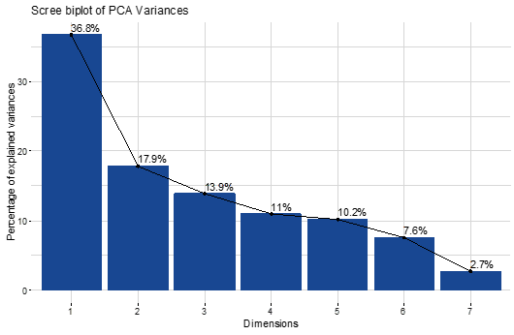
Feature Engineering
Response Variables were selected using Principal Component Analysis(PCA).
Based on PCA loadings, Global active power, Sub metering 3, and Global reactive power are the most significant features.
PCA Metric | PC1 | PC2 | PC3 | PC4 | PC5 | PC6 | PC7
Standard deviation | 1.6047 | 1.1187 | 0.9867 | 0.8761 | 0.8438 | 0.72858 | 0.4356
Proportion of Variance | 0.3679 | 0.1788 | 0.1391 | 0.1096 | 0.1017 | 0.07583 | 0.0271
Cumulative Proportion | 0.3679 | 0.5466 | 0.6857 | 0.7954 | 0.8971 | 0.97290 | 1.0000
Notes:
Point 4: (PCA) : The first three principal components explained 68.57% of the total variance.

Slide 8
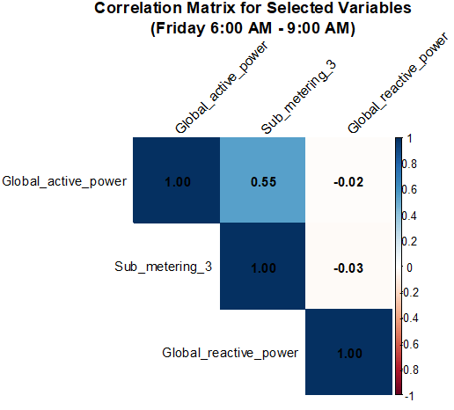
Correlation of Responses
Global_reactive_power
Sub_metering_3
Global_active_power
Power consumption in the grid
Statistical Metric | Global_active_power | Global_reactive_power | Sub_metering_3
Minimum | -1.197 | -1.15 | -0.709
Maximum | 3.838 | 3.462 | 3.075
Mean | 0.01576 | 0.008 | 0.004
PCA | -0.497 | -0.687 | -0.49
Range | High | Low | Medium
Necessary for maintaining the voltage levels
Power use from a particular area

Slide 9
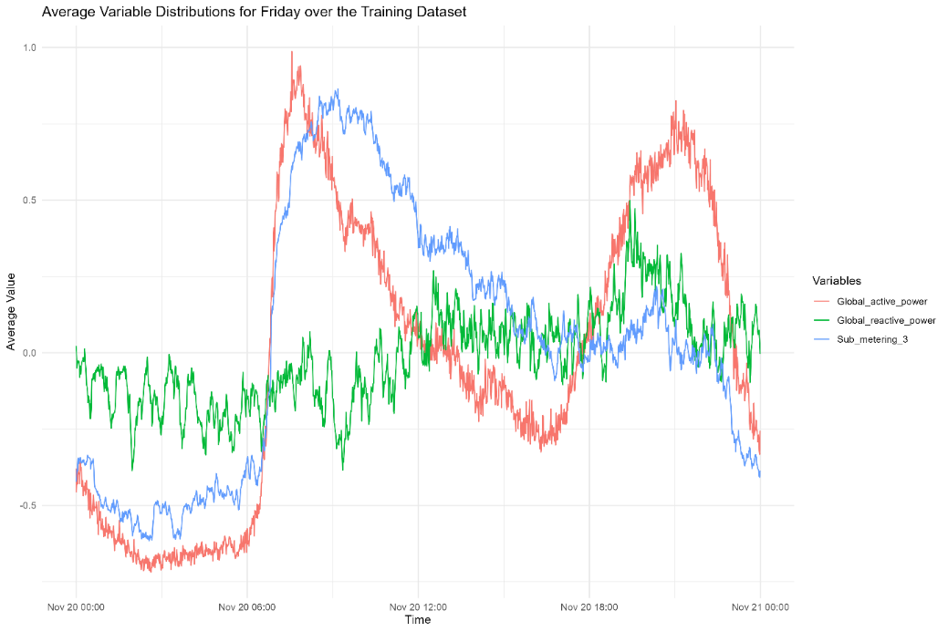
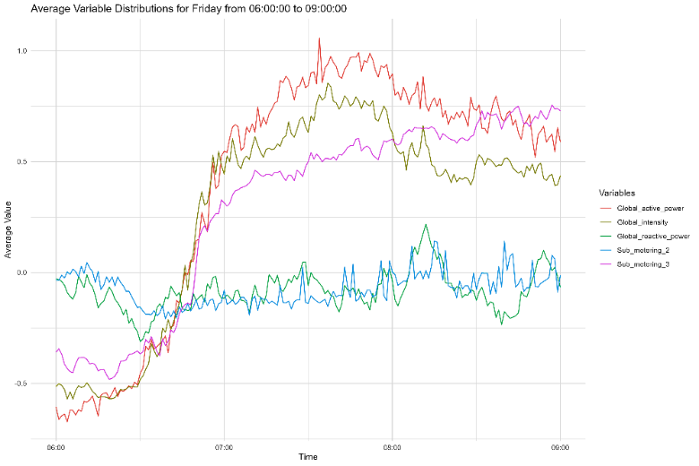
Time Window
Graph describing average chosen variable distribution across selected weekday
Graph describing average variable distribution across chosen time window

Slide 10
Splitting Of Dataset
Fridays
6:00 AM to 9:00 AM
Testing Data
~ 44 Weeks
Jan. 25, 2009 onwards
Training Data
~ 110 Weeks
Dec. 16, 2006 – Jan. 24, 2009
Notes:
Point 4: (PCA) : The first three principal components explained 68.57% of the total variance.

Slide 11

Splitting Of Dataset…
The larger training data allows the HMM model to learn diverse patterns across all temporal variations.
Sufficient data fed to the HMM model reduces the risk of overfitting to short-term patterns.
The test data time has to follow the training data time to test the model's performance under conditions of temporal drift.
This Photo by Unknown Author is licensed under CC BY-SA-NC
Notes:
First point: the training data spans 2 years allows learning all energy patterns throughout all weekdays, weekends, seasons.
Third point: can add temporal drifts which is common in energy consumption patterns due to changing user behavior or external factors like weather.
Forth Point: By maintaining this focus in both datasets, the model avoids being influenced by irrelevant data, ensuring a more accurate detection of anomalies.

Slide 12
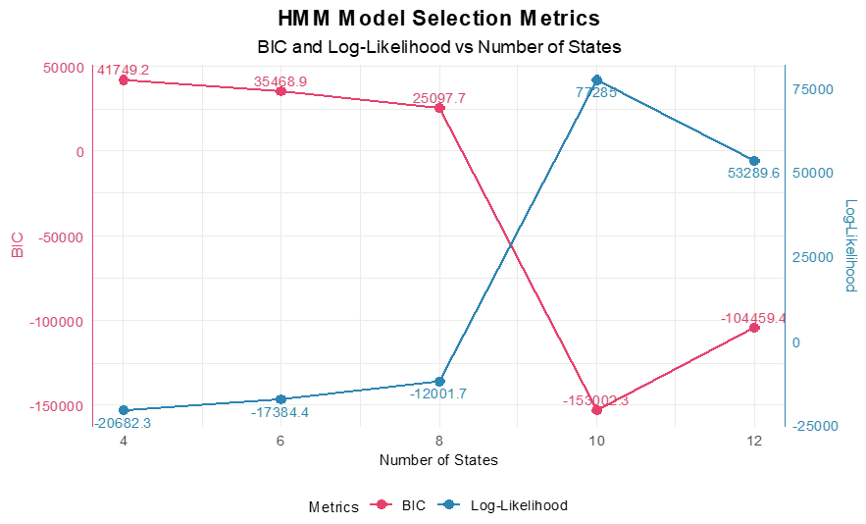
Model Design
The state counts (4, 6, 8, 10, 12) were explored using the log-likelihood and Bayesian Information Criterion (BIC).
The 6th-state HMM was chosen for it's balance of performance and complexity, as it produced a log-likelihood of –17384.45 and BIC of 35468.91.
The Gaussian Distribution was chosen.
To ensure consistency we transferred the parameters form the trained model to the test model.
Notes:
Third point: This distribution was chosen as it aligned with the continuous nature of the consumption data.
Forth point: it would ensure that there is transfer of probabilities and state distribution during the testing period.

Slide 13
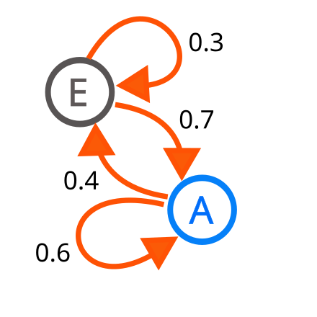
The distribution has the ability to well-approximate data that shows natural variability, energy consumption.
The number of states in an HMM essentially controls the granularity of the model’s representation of underlying patterns in the data.
The 6th-state model was chosen because of the best balance between complexity and fit.
To ensure consistency between training and testing,the parameters (state transition probabilities and emission distributions) were transferred from the trained to the test model using the setpars() function.
This Photo by Unknown Author is licensed under CC BY-SA
Notes:
First point there are some things we can say addditonal: The Gaussian response family allows the model to capture the probabilistic nature of energy consumption at different states, such as typical or anomalous usage patterns.
Second point: The 6-state model was chosen based on the balance between model complexity and fit. Evaluation metrics like log-likelihood and BIC showed that the model was neither overfitting nor underfitting, making it optimal for capturing typical consumption patterns while avoiding unnecessary complexity.
Third point:

Slide 14
Anomaly Detection
Deviation was identified by comparing log-likelihood of test and training data.
Normalized log-likelihood threshold defined on maximum deviation observed in test subsets.
Test Data divided into 10 equal-size subsets to capture temporal patterns.
A threshold of -17452.07 log-likelihood and –1.005208 for normalized log-likelihood was established.
Synthetic anomalies were introduced to the test data which included point & temporal anomalies.
Notes:
Point 4: (PCA) : The first three principal components explained 68.57% of the total variance.

Slide 15
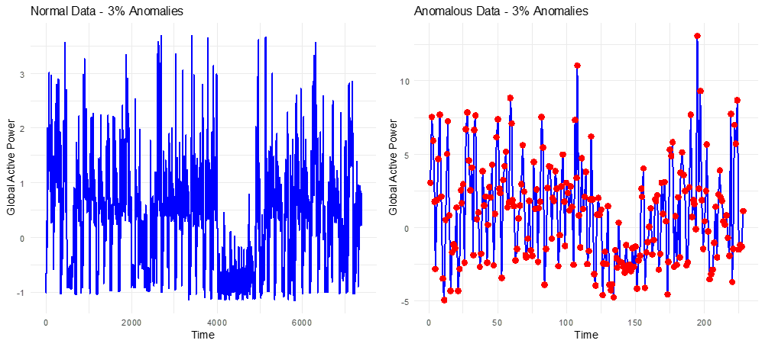

Slide 16

Low log-likelihood values indicate that model has not learned to represent the observation, detecting potential anomalies.
Threshold was derived by calculating maximum deviation between log-likelihood of training and test data.
Subset Analysis of Data reflects the need for adaptive anomaly detection
By injecting synthetic anomalies, we tested for the frameworks ability to detect known deviations.
This Photo by Unknown Author is licensed under CC BY-ND
Notes:
Third point: especially for systems like energy grids where consumption patterns may evolve gradually (e.g., seasonal changes, holidays, or behavioral shifts).

Slide 17
Challenges
01
Identifying most relevant features due to complexity of energy consumption patterns.
02
State Configuration Selection based on log-likelihood and BIC values.
03
Dynamic threshold for Anomaly detection to balance false positives and false negatives.
04
Realistic Anomaly Stimulation needed to be diverse enough.
Notes:
Point 1: and the need to balance dimensionality reduction with preserving essential variance.
Point 3: Establishing a robust threshold for log-likelihood deviations required iterative testing to balance false positives and false negatives.
Point 4: The injected anomalies needed to be diverse enough to evaluate the robustness of the framework effectively.

Slide 18
Lesson Learnt
01
Future Scaling Matters Dimensionality reduction techniques like PCA not only simplify the model but also enhance interpretability.
Model Configuration is Curtail Choosing the optimal number of HMM states are a balance between complexity and performance.
Anomaly Injection Validates Robustness Injecting synthetic anomalies provides an effective way to test and refine the model.
02
04
Thresholds should be Data-Driven Empirical methods for determining thresholds, such as calculating maximum log-likelihood deviation, are more effective than static thresholds.
Iterative Refinement Yields Better Results Each phase of the project—preprocessing, model training, threshold determination, and anomaly detection—benefited from iterative refinement.
03
05

Slide 19
— Conclusion
01
Effective data preprocessing and dimensionality reduction using PCA
02
Optimal 6-state HMM configuration balancing performance and complexity
03
Robust anomaly detection framework with data-driven thresholds
04
Successful identification of both natural deviations and injected synthetic anomalies

Slide 20
Thank You

Slide 21
References
[1] L. R. Rabiner, “A tutorial on hidden Markov models and selected applications in speech
recognition,” Proc. IEEE, vol. 77, no. 2, pp. 257–286, Feb. 1989, doi: 10.1109/5.18626.
[2] A. Nassar, “Answer to ‘Hidden Markov models and anomaly detection,’” Cross Validated.
Accessed: Nov. 24, 2024. [Online]. Available: https://stats.stackexchange.com/a/135946
[3] I. Visser and M. Speekenbrink, “depmixS4 : An R Package for Hidden Markov Models,” J. Stat.
Soft., vol. 36, no. 7, 2010, doi: 10.18637/jss.v036.i07.
[4] N. Goernitz, M. Braun, and M. Kloft, “Hidden Markov Anomaly Detection,” in Proceedings of the 32nd International Conference on Machine
Learning, PMLR, Jun. 2015, pp. 1833–1842. Accessed: Nov. 24, 2024. [Online]. Available:
https://proceedings.mlr.press/v37/goernitz15.html
[5] “Principal Component Analysis (PCA) in R Tutorial.” Accessed: Nov. 24, 2024. [Online].
Available: https://www.datacamp.com/tutorial/pca-analysis-r

